Slide 1
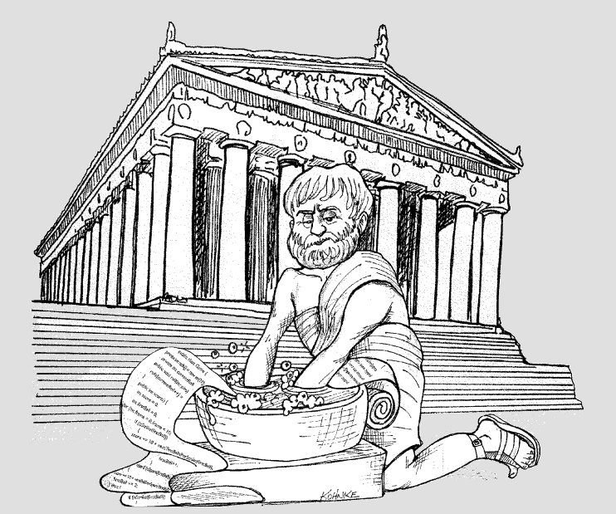
Clean Code
by Alexandr Efimov
November 2018
skype: oleksandr.yefymov

Slide 2
Agenda & Topics
What is clean code
How to measure code quality
Why to write clean code
How to write clean code
Principles & Practices
naming
functions
comments
formatting
classes & objects
Refactoring
Static code analyzers
Patterns & Antipatterns
What is next
Q & A

Slide 3

What is clean code
`I like my code to be elegant and efficient. The logic should be straightforward and make it hard for bugs to hide, the dependencies minimal to ease maintenance, error handling complete according to an articulated strategy, and performance close to optimal so as not to tempt people to make the code messy with unprincipled optimizations. Clean code does one thing well.`
Bjarne Stroustrup, inventor of C++

Slide 4
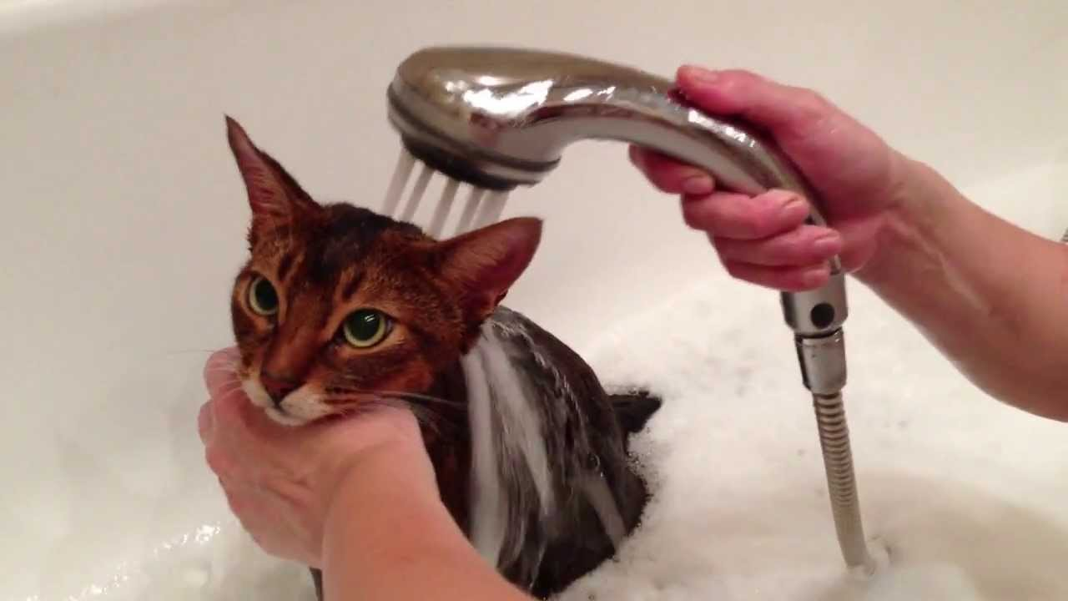
What is clean code...
Source code to be clean must be:
readable
simple
well structured
extensible
maintainable
testable

Slide 5
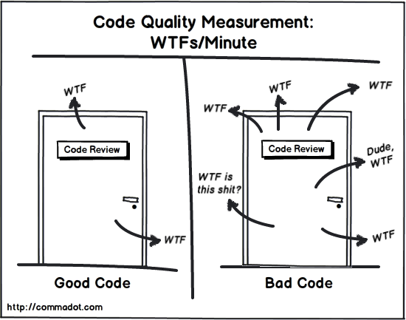
How to measure code quality
`The only valid measurement of code quality is the number of WTFs per minute`
Robert Martin in his book `Clean Code`

Slide 6
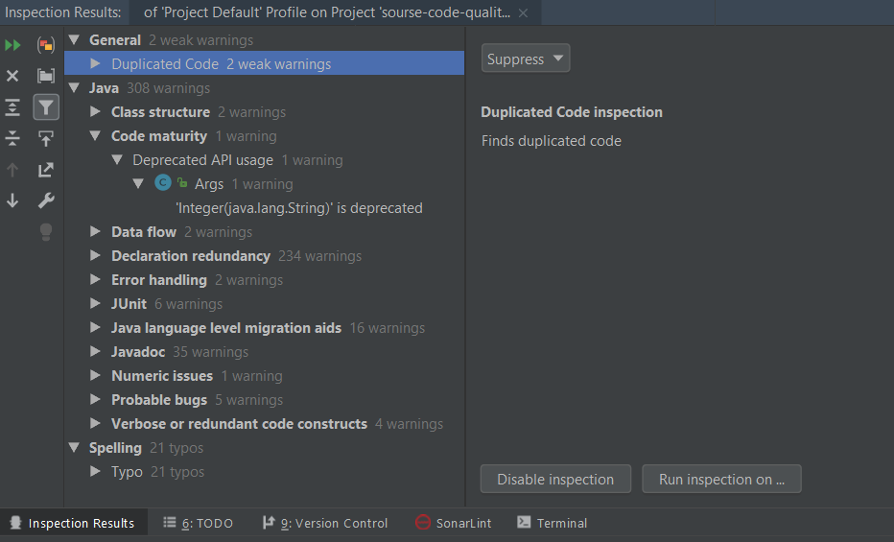
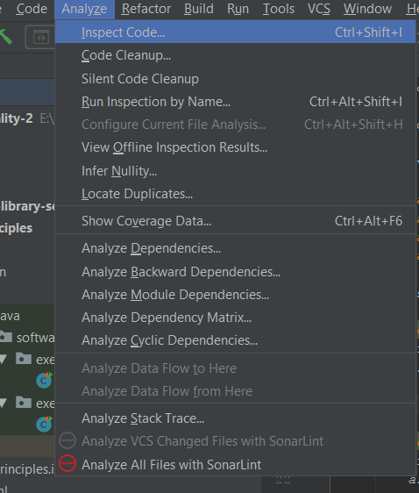
How to measure code quality...
Static code analyzers & code inspectors

Slide 7
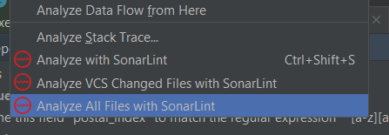
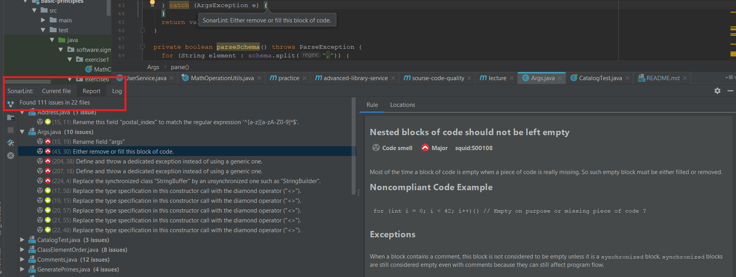
How to measure code quality...
Static code analyzers & code inspectors

Slide 8
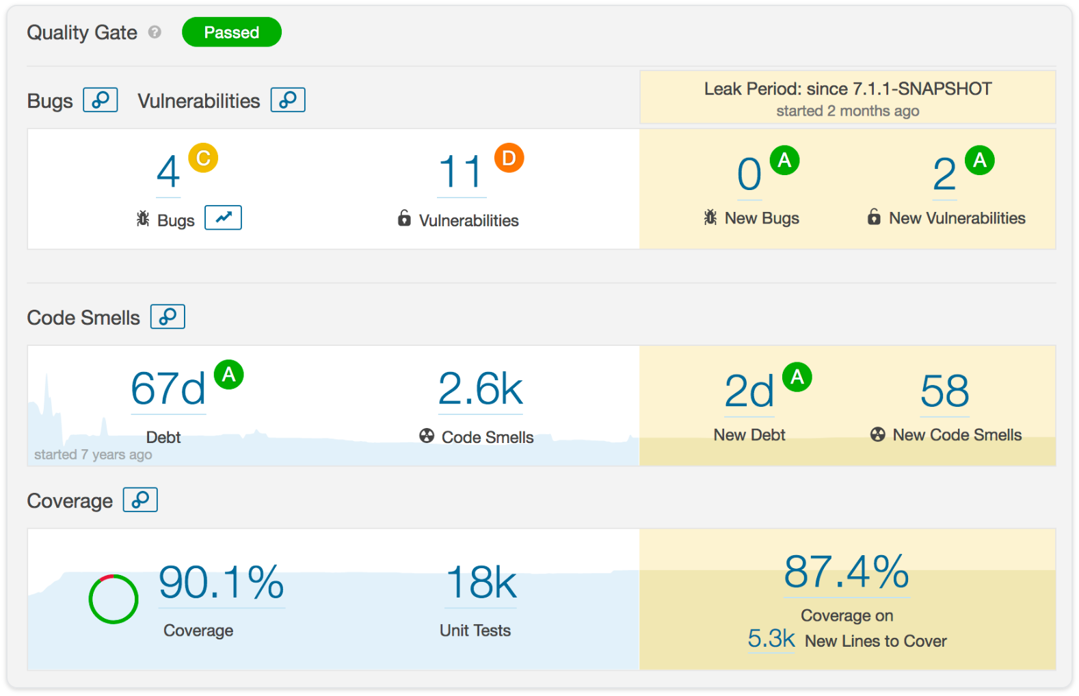
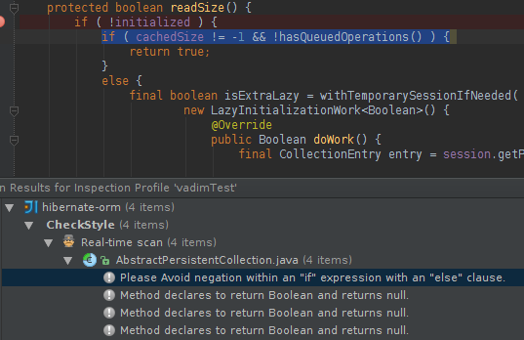
How to measure code quality...
Static code analyzers & code inspectors
Summarizing:
code review
static code analyzers

Slide 9
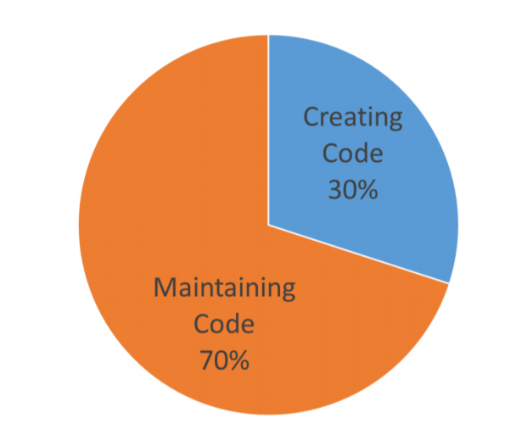
Why to write clean code?
As developers we spend much more time on code reading that writing. The most optimistic statistic says we read code ~70%, and write - only 30%.
Clean code makes it easier to:
Write new code
Maintain old code

Slide 10
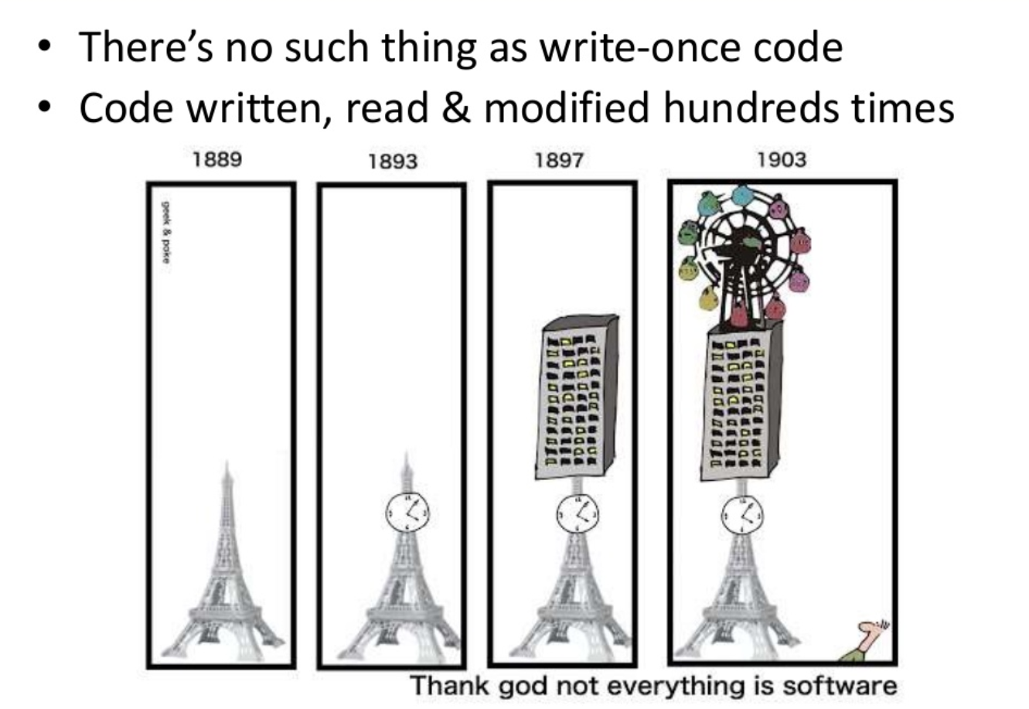
Why...

Slide 11
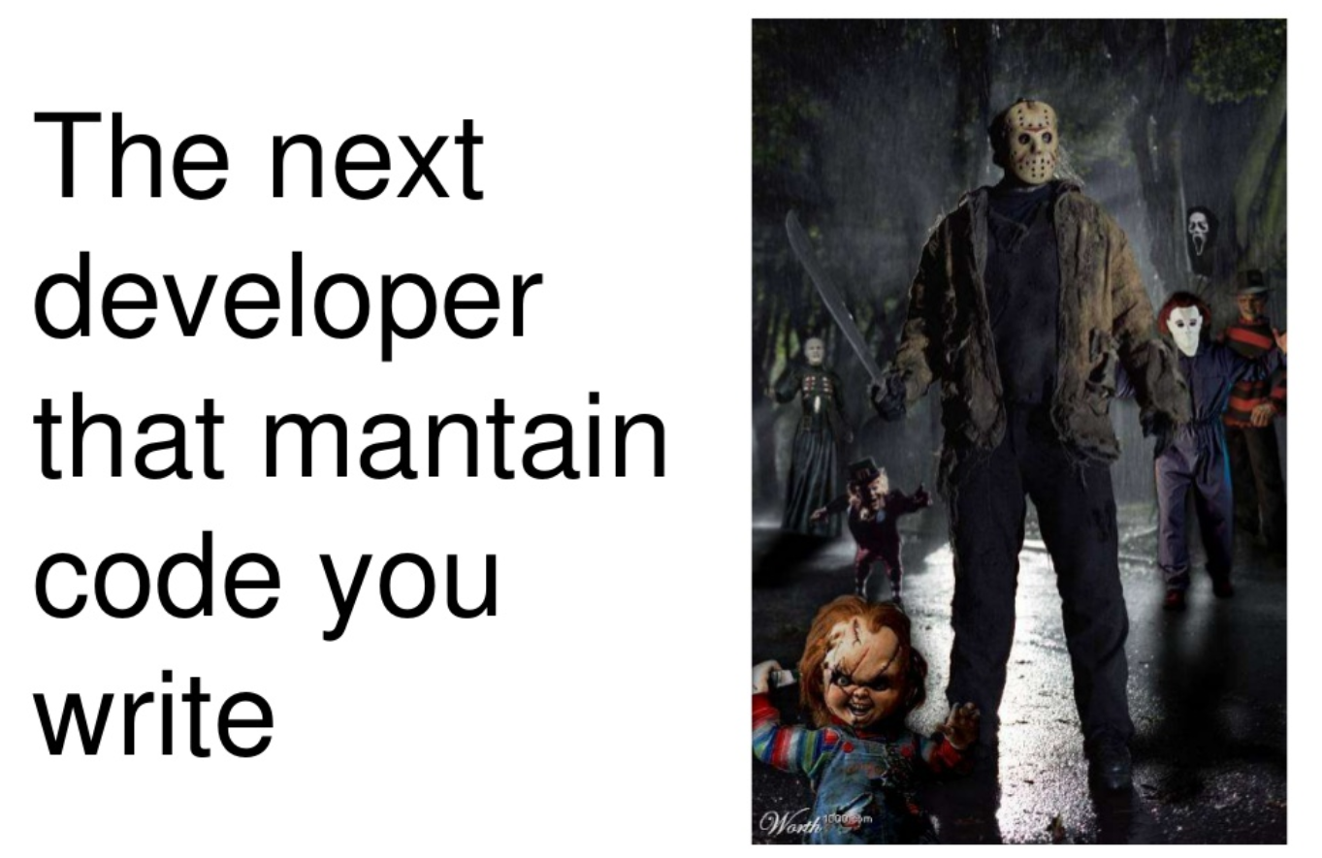
Why...
Maintaining...
Rule of Thumb:
Imagine that the developer who comes after you is a homicidal maniac who knows where you live.
Unknown

Slide 12
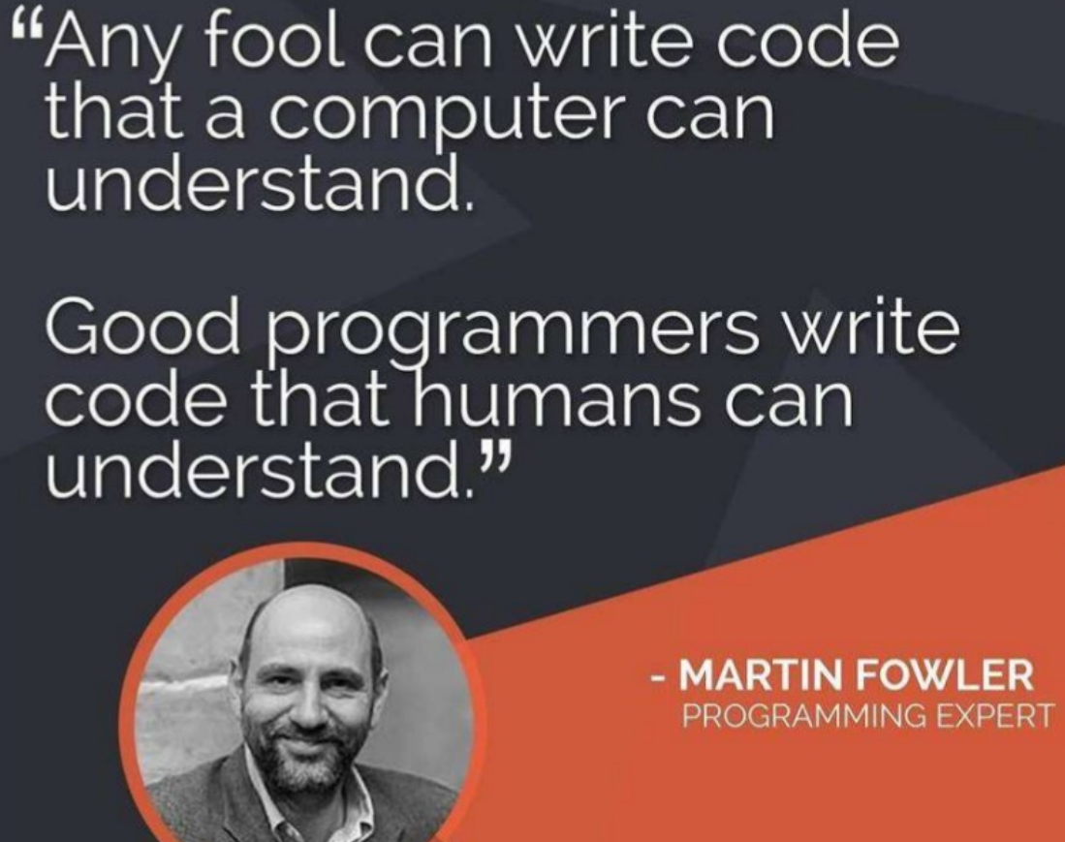
We get the Why reasons, so...what is next?
...Next is - How to write clean code.

Slide 13
How to write clean code?
Practices & Principles:
Naming
Functions
Comments
Formatting
Classes & Objects
Refactoring
Patterns & Antipatterns

Slide 14

Naming
We name and name and name.
Because we do so much of it, we’d better do it well

Slide 15
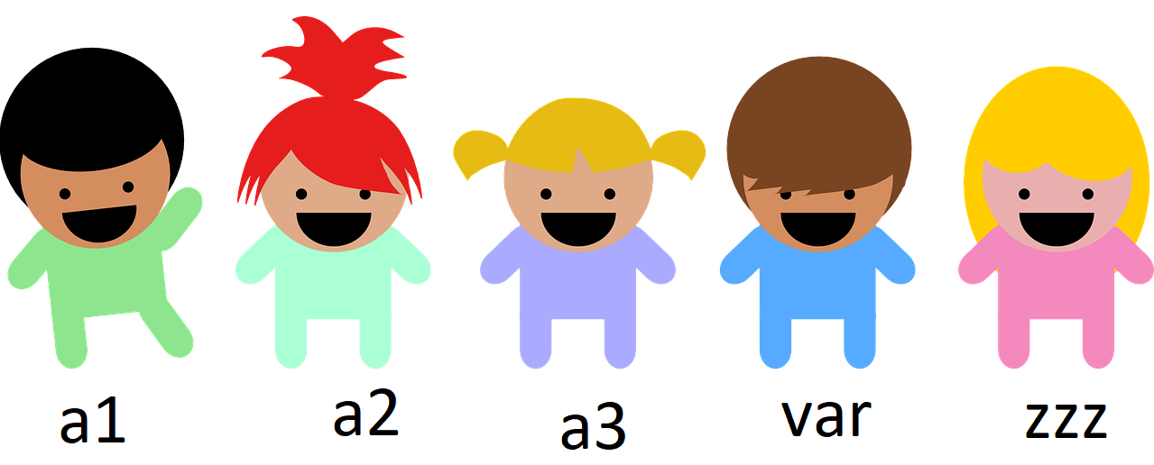
Naming
The name of a variable / function / class / interface / package / module / project should answer all the big questions. It should tell you:
why it exists
what it does
how it is used
If a name requires a comment, then the name does not reveal its intent.

Slide 16
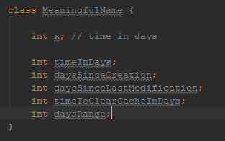
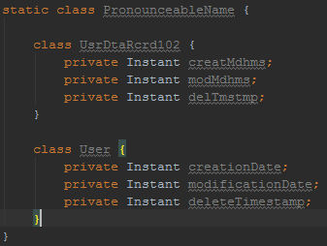
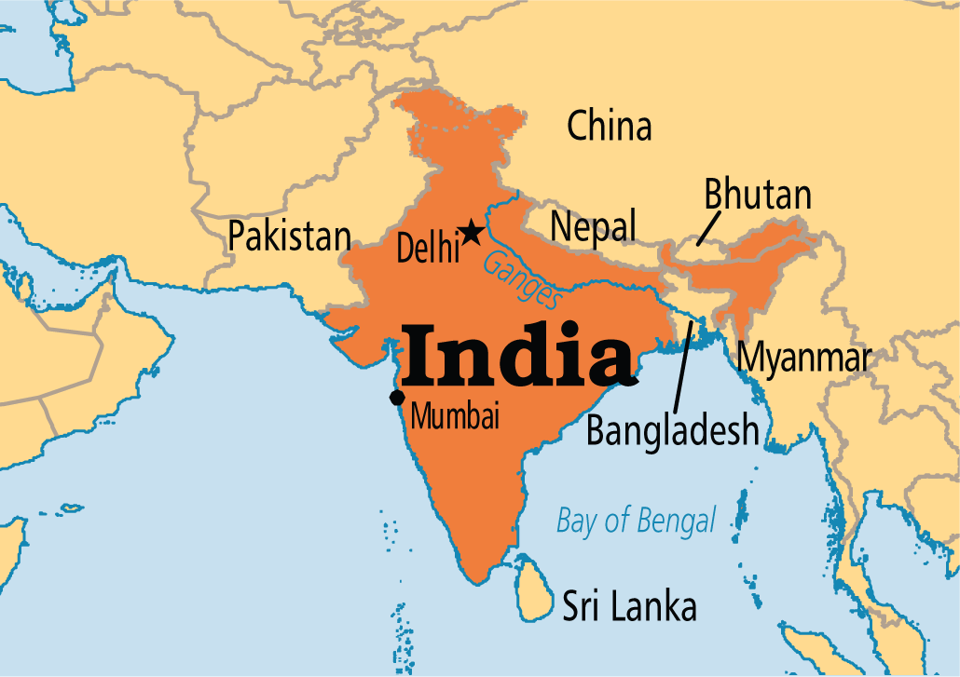
Naming...
1. Use intention revealing names
2. Use pronounceable names

Slide 17
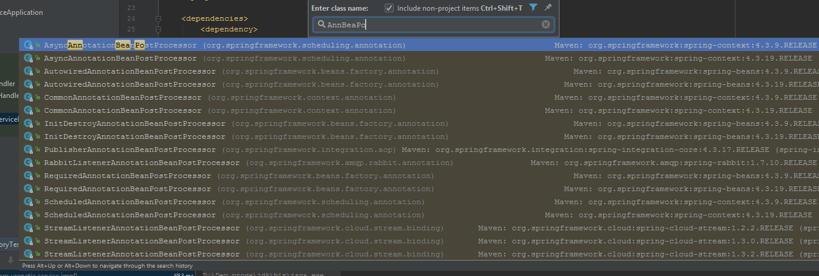
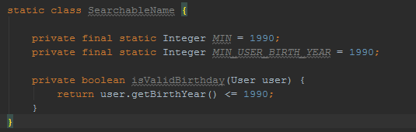
Naming...
3. Use searchable names. Avoid acronyms, missing letters, magic numbers/strings

Slide 18
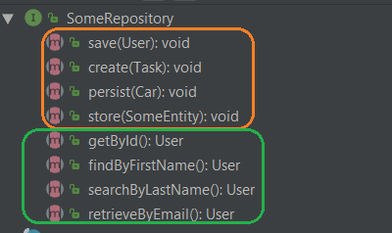
Naming...
4. Be consistent. Pick one word per concept across whole project
If you use get don’t then use fetch, retrieve or obtain unless doesn’t have different concept. Be consistent in the names given to variables, methods, classes etc.
When new developers are in team, guide them with project naming conventions (for that convention of course should be present) and be strict with that during code review

Slide 19
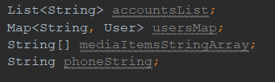
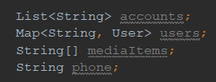
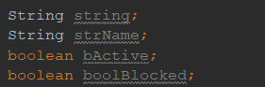
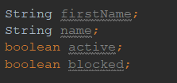
Naming...
5. Avoid encodings.
Types types in names
Hungarian Notation (Wiki)
vs
vs

Slide 20


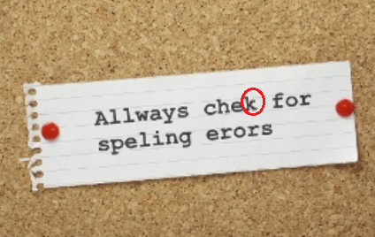
Naming...
5. Avoid grammatical errors, typos.
Mariner 1, 1962 year

Slide 21
Naming...
Class Names
Classes and objects should have noun or noun phrase names like Customer, WikiPage, Account, and AddressParser. Avoid words like Manager, Processor, Data, or Info in the name of a class. A class name should not be a verb.
Functions
Verb with clear intention - save/find/contains etc.

Slide 22
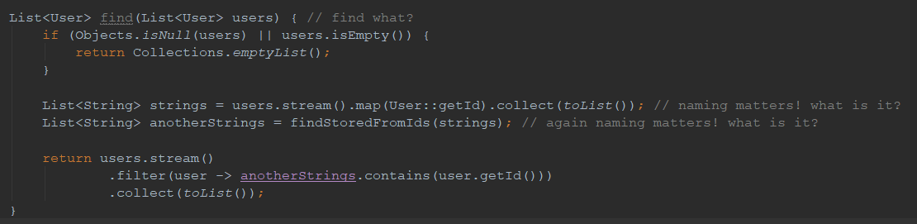
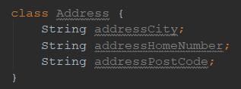
Naming...
Why it is important...

Slide 23
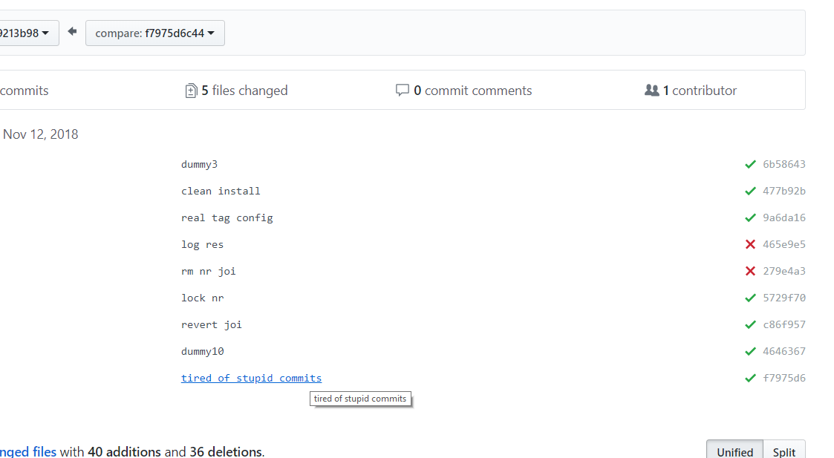
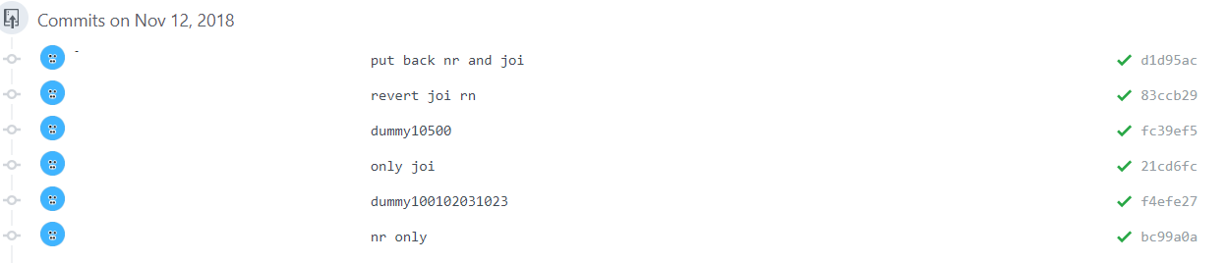
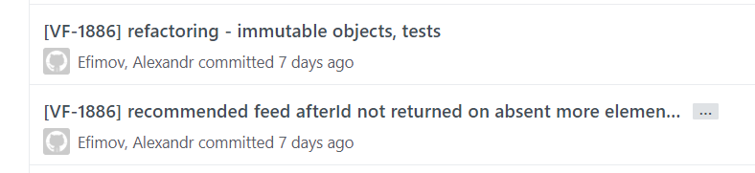
Naming...
And it is important everywhere, in git commits also
vs

Slide 24
Naming conclusion
Spending time on naming is a good deal at any time
Use code conventions, project guidelines, be consistent
While naming something you should be able to answer questions:
why it exists
what it does
how it is used

Slide 25
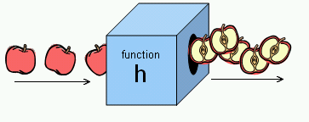
Functions
size - keep small
do one thing and do it good (SPR - single responsibility)
avoid side effects
meaningful name
early return
arguments. The less parameters - the better, 0 or 1 is preferable. If can’t - pass object
avoid boolean variables as arguments
don’t repeat yourself (DRY)

Slide 26
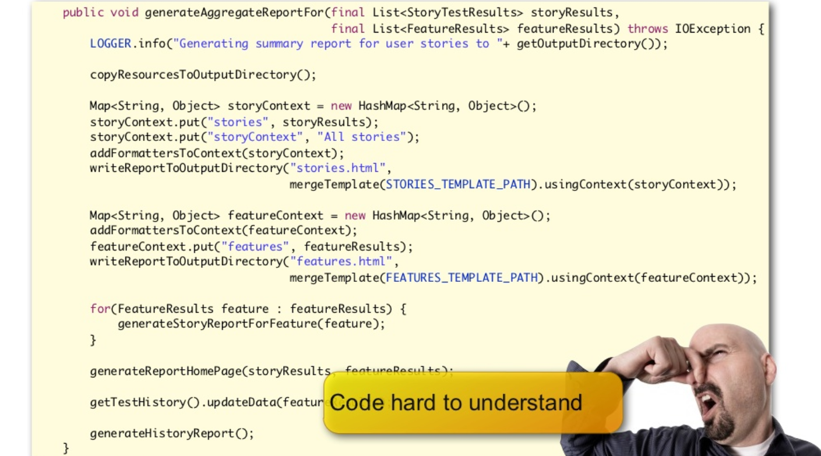
Functions...
small
In general, if you end up with a method longer than 10-15 lines of code you should take a look over it and see why it is so long.
Potential fixes - extract logic to private methods, separate concepts, use abstraction

Slide 27
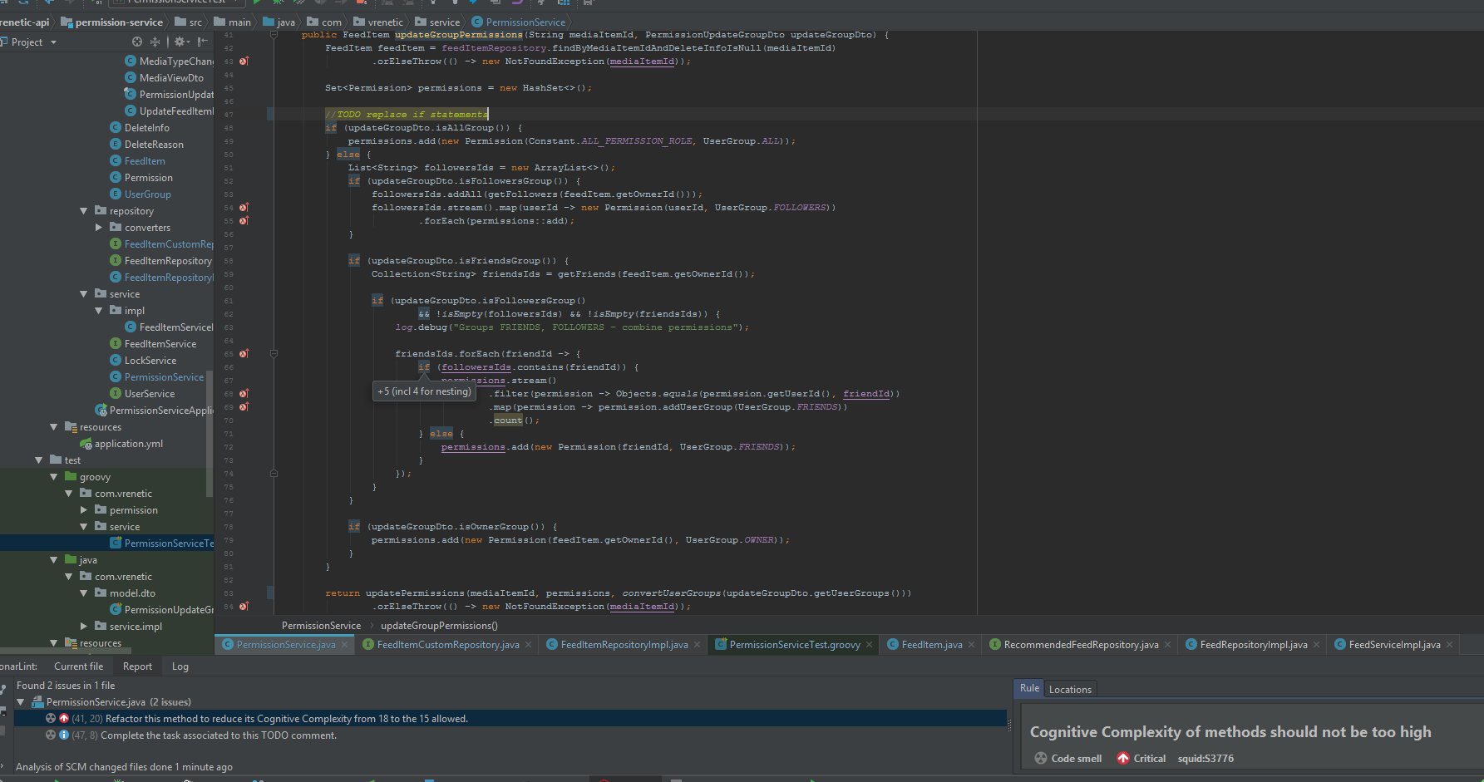
Functions...
small

Slide 28
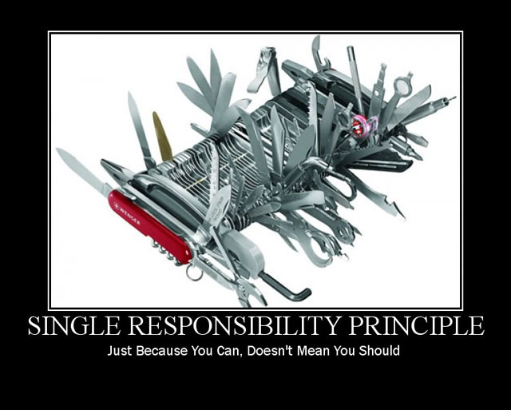
Functions...
do one thing and do it good (single responsibility)
If you need to do more than one thing, than you should split it into separate functions. The reason we write functions is to decompose a larger concept (in other words, the name of the function) into a set of steps at the next level of abstraction.
It brings easy in:
understand
maintain
reuse

Slide 29
Functions...
side effects
getUserById(String id){
User user = userRepository.findOne(id);
user.setBlocked(true);
save(user);
return user;
}
meaningful name
Methods name - verb or verb phrase (like postPayment, deletePage, save)
Accessors, mutators, and predicates should be named for their value and prefixed with get, set, and is according to the javabean standard.
When constructors are overloaded, use static factory methods with names that describe the arguments. For example, Complex fulcrumPoint = Complex.FromRealNumber(23.0); is generally better than Complex fulcrumPoint = new Complex(23.0); Consider enforcing their use by making the corresponding constructors private.

Slide 30
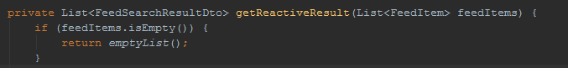
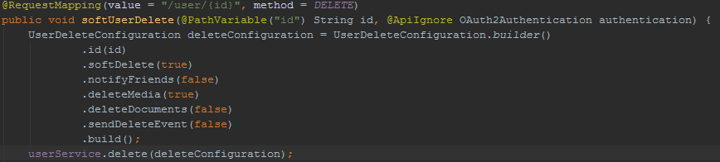
Functions...
early return
Early return is preferable instead of wrapping all the function code into if statement
arguments. avoid boolean variables as arguments
The ideal number of arguments for a function is zero. Three or more requires very special justification — they can and in most cases should be replaced with object instead.

Slide 31
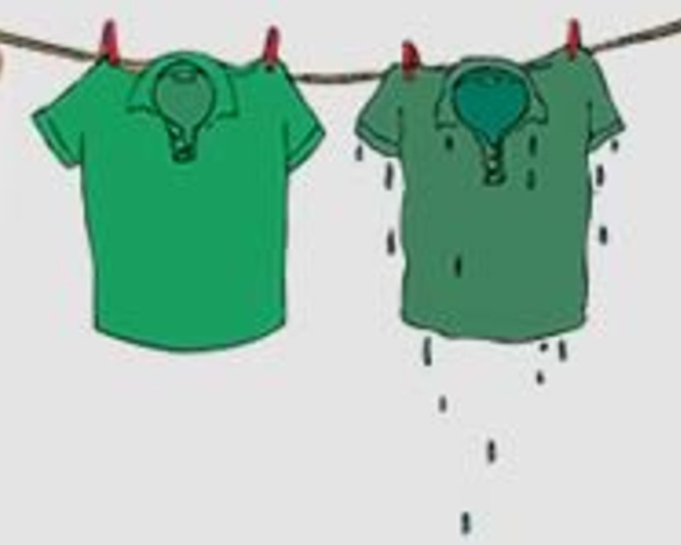
Functions...
don’t repeat yourself(DRY principle) - reuse logic, the Rule of three ("Three strikes and you refactor")
DRY code vs WET code

Slide 32
Functions conclusion
Name functions/methods using a verb, according to their context and what they do
Should be as small as possible
Should have an explicit intent, both in its name and code
Should do one thing only and do it well. One thing means one level of abstraction and one `action`
Should have at most 3 arguments, if we have more than 3 and they are conceptually related, we should group them in an object
Avoid boolean arguments, use 2 functions/methods instead
Comply to CQS, either:
– Do something (change state)
– Get something (return info about an object)
Don’t return an error code, throw an exception instead
Blocks inside conditionals or loops should be one line long, a function call which, if named correctly, adds documentary value (good style)
by Uncle Bob

Slide 33
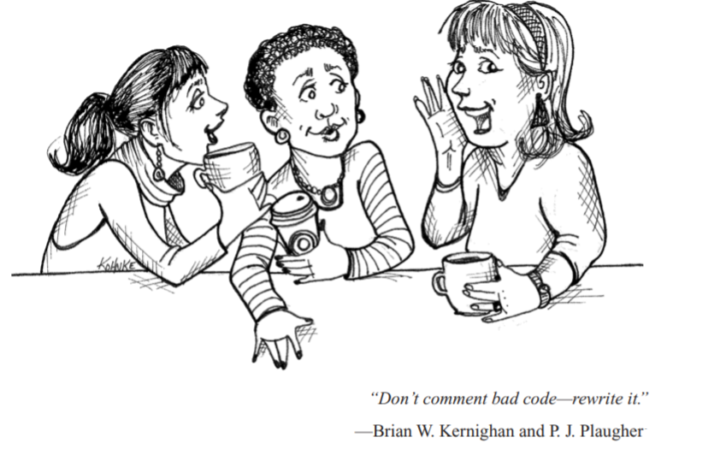
Comments
Nothing can be quite so helpful as a well-placed comment. Nothing can clutter up a module more than frivolous dogmatic comments. Nothing can be quite so damaging as an old crufty comment that propagates lies and misinformation.
Clean Code, Martin

Slide 34
Comments...
When NOT comment:
good code is self documented and not requires comments
during refactoring, if there were comments, big change they won’t be updated and will lie
dead commented code should never exist in project
Valid cases:
legal reasons, informative
warnings, informing something
public API (Java Docs)

Slide 35
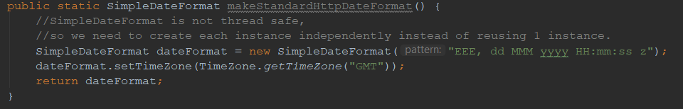
Comments…(good)

Slide 36
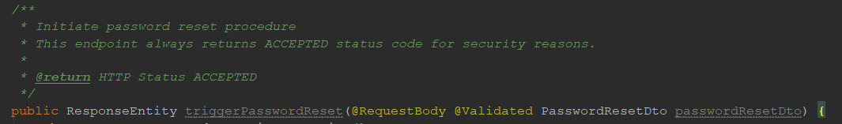
Comments…(good)

Slide 37
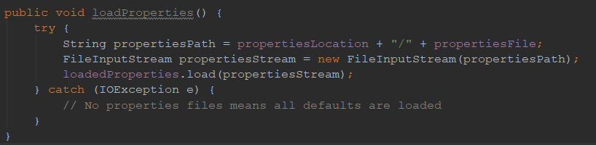
Comments…(bad)
Most comments fall into this category. Usually they are crutches or excuses for poor code or justifications for insufficient decisions, amounting to little more than the programmer talking to himself.
Mumbling

Slide 38
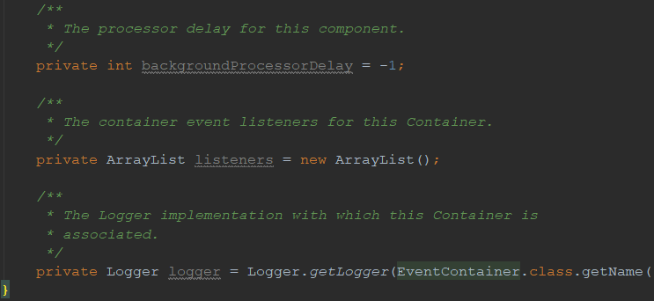
Comments…(bad)
Redundant comments

Slide 39
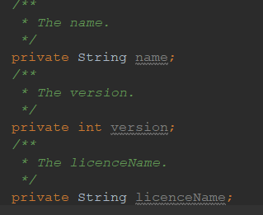
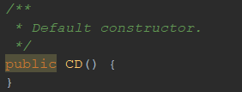
Comments…(bad)
Noise, mandatory comments
Journal Comments - use Version Control System instead

Slide 40
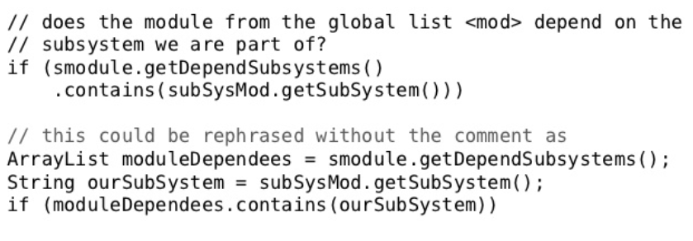
Comments…(bad)
Don’t Use a Comment When You Can Use a Function or a Variable

Slide 41
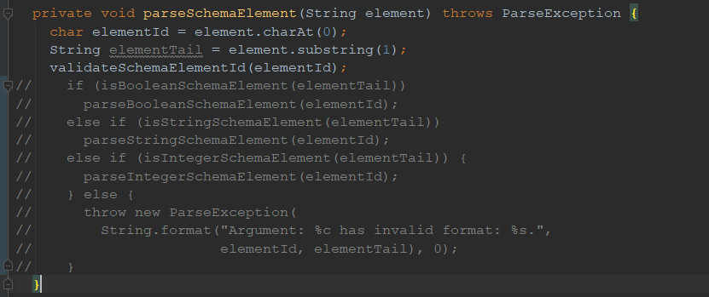
Comments…(bad)
Commented code
Delete, delete, delete it!

Slide 42

Comments...
Conclusions
Always explain yourself in code, without comments.
Don't be redundant.
Don't add obvious noise.
Don't use closing brace comments.
Don't comment out code. Just remove.
Use as explanation of intent.
Use as clarification of code.
Use as warning of consequences.
Use public API documentation

Slide 43
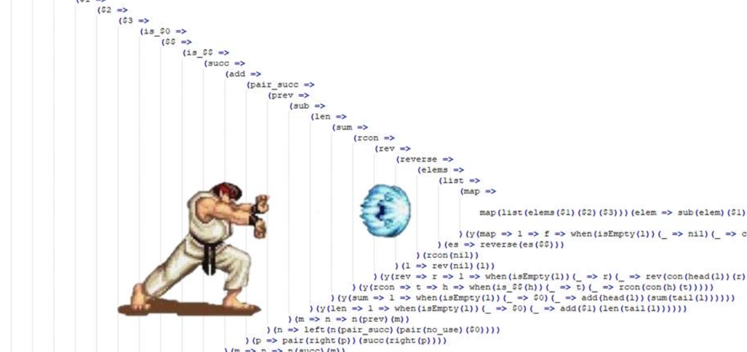
Formatting
Code formatting is about communication, and communication is the professional developer’s first order of business.
Clean Code, Martin

Slide 44
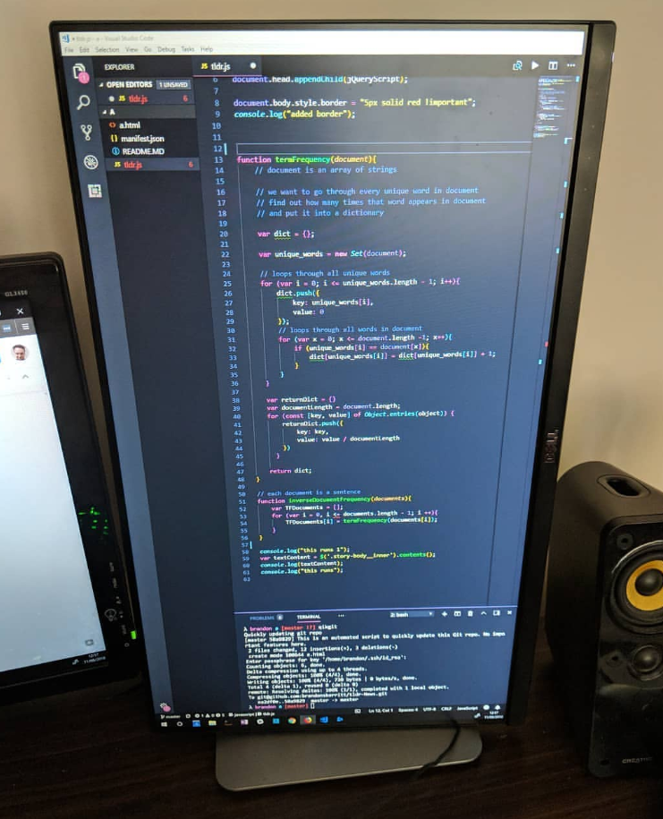
Formatting...
Vertical formatting
File size
Horizontal formatting
Keep lines short
Declare variables close to their usage
Dependent functions should be close
Similar functions should be close
Don't break indentation
Use IDE auto formatting

Slide 45

Formatting...
Vertical formatting
Try to keep max length smaller. The smaller - the better (1 screen size is cool)
Separate concepts with blank lines
The Newspaper Metaphor
read it vertically – headlines at the top, detail increases as we go down the page

Slide 46
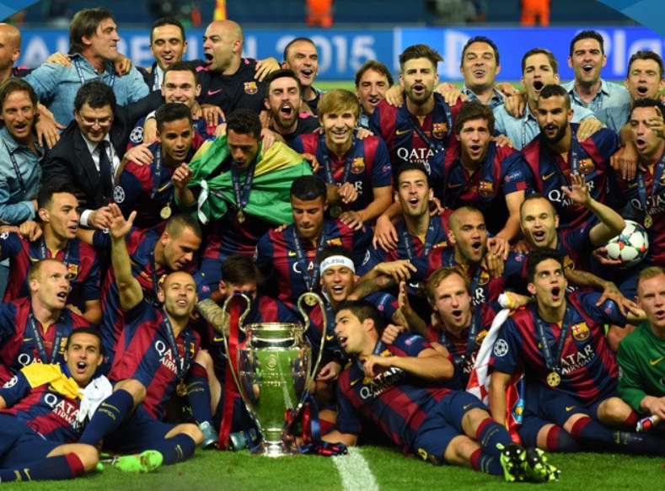
Formatting...
Be a team player
Each developer can have own code style preferences, ideas what is better - but working on project in team - go with that according to guidelines/conventions.

Slide 47
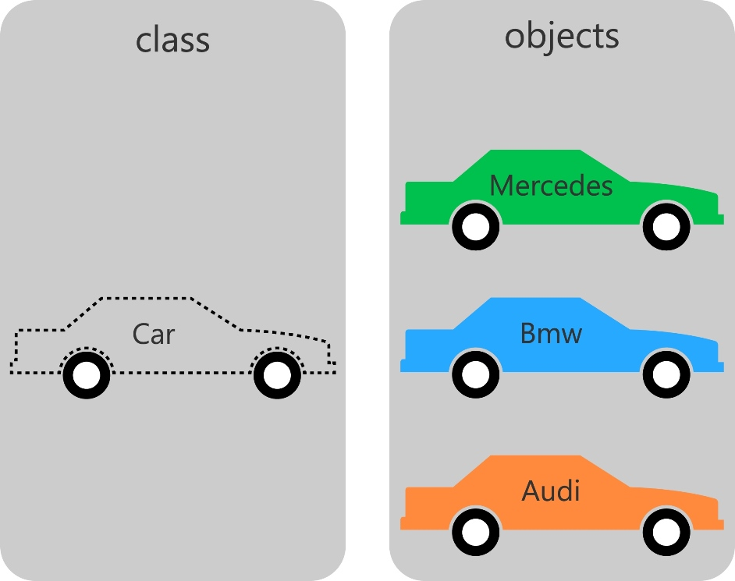
Classes & Objects
In the class-based object-oriented programming paradigm, object refers to a particular instance of a class, where the object can be a combination of variables, functions, and data structures.
Class is an extensible program-code-template for creating objects.
Wiki

Slide 48


Classes & Objects...
Objects & data structures

Slide 49

Classes & Objects...
Objects & data structures
In this solution the shapes are Data Structures, while Geometry class is Object
Advantage: If you need to add more methods you will add them only in the Geometry class (this is the time this solution should be implemented).
Disadvantage: If you need to add more Data Structures (i.e. more shapes), you will have to change all your methods in the Geometry class.

Slide 50


Classes & Objects...
Objects & data structures
In this solution, there is no Data Structures, only Object classes.
Advantage: If you want to add more shapes, you don't have to change any of the old code. Disadvantage: If you want to add new methods you will have to add them in all the previous classes

Slide 51

Classes & Objects...
Objects & data structures
So in order to write clean code: avoid making Hybrid classes which have functions that do significant things, and they also have either public variables or public accessors and mutators that, for all intents and purposes, make the private variables public, tempting other external functions to use those variables the way a procedural program would use a data structure.
Also in order to write good code that have the ability to grow without problems, you have to decide whether to choose the procedural or OO way based on the problem in hand.

Slide 52

Classes & Objects...
Order matters
Size. Classes should be small
SPR. Single responsibility principle (wiki SPR)
Isolating from change

Slide 53
Classes & Objects...
Order Matters
Class elements order depend on coding standards/conventions you are using, widespread example:
public static constants, private constants
private variables
public functions
private methods after the public function that calls it
Size. Classes should be small
not more than 1 screen
with counting lines also count responsibilities
name describes purpose
if you cannot derive a good class name, it’s probably too large / with too broad scope - split to multiple classes

Slide 54

Classes & Objects...
Classes should adhere to SRP
SRP, Single Responsibility Principle (Wikipedia): The S in SOLID
Many small classes is better
Large, multipurpose classes force us to scroll through code that we don’t need to know about right now.
Isolating from Change
DIP, Dependency Inversion Principle (Wikipedia): The D in SOLID - classes should depend on abstractions, not concrete details
Behaviour should not be broken due to change in parent component (implementation usage with `super`)

Slide 55

On the way...
What?
Why?
How?
principles part already
practices is next

Slide 56

Refactoring
Code refactoring is the process of restructuring existing computer code - changing the factoring - without changing its external behavior.
Refactoring improves nonfunctional attributes of the software.
Advantages include improved code readability and reduced complexity; these can improve source-code maintainability and create a more expressive internal architecture or object model to improve extensibility.
Wiki

Slide 57

Refactoring...
Why?
When?
How?

Slide 58

Refactoring...
Why?

Slide 59

Refactoring...
Why?

Slide 60
Refactoring...
When?
You should refactor
Any time that you see a better way to do things
"Better" means making the code easier to understand and to modify in the future
You can do so without breaking the code
Unit tests are essential for this
You should not refactor:
Stable code (code that won't ever need to change)
Someone else's code

Slide 61

Refactoring...
When?

Slide 62


Refactoring...
How?
Top 6 Refactoring Patterns to improve 80% in code quality
Extract class/ move method
Extract method
Decompose conditional
Introduce parameter object
Replace magic number, string
Rename

Slide 63

Refactoring...
Techniques overview

Slide 64

Refactoring...
Techniques overview

Slide 65

Refactoring...
Techniques overview

Slide 66

Refactoring...
Techniques overview

Slide 67

Refactoring...
Techniques overview

Slide 68

Refactoring
Know your tools

Slide 69

Refactoring...
Good resources for refactoring techniques learning, practice - sourcemaking. Otherwise use Fowler's refactoring book!

Slide 70


Static code analyzers
Checkstyle
focuses on coding conventions and standards are respected
PMD (Cross-language)
focuses on preemptive defect detection - typical anti-patterns, vulnerabilities
FindBugs
doesn’t concern the formatting or coding standards but is only marginally interested in best practices.it concentrates on detecting potential bugs and performance issues and does a very good job of detecting a variety of many types of common hard-to-find coding mistakes, including thread synchronization problems, null pointer dereferences, infinite recursive loops, misuse of API methods etc

Slide 71

Static code analyzers
SonarQube (Cross-language)
Sonar uses FindBugs, Checkstyle and PMD to collect and analyze source code for bugs, bad code, and possible violation of code style policies. It examines and evaluates different aspects of your source code from minor styling details, potential bugs, and code defects to the critical design errors, lack of test coverage, and excess complexity. At the end, Sonar produces metric values and statistics, revealing problematic areas in the source that require inspection or improvement. In recent years it has become a world’s leader in Continuous Inspection of code quality management systems.

Slide 72


Static code analyzers
SonarQube

Slide 73


Static code analyzers
SonarLint
IDE extension for on the fly code analysis. Using same to SonarQube SonarSource technology

Slide 74

Static code analyzers
SonarLint

Slide 75


How to measure code quality...
Code inspectors in IDE

Slide 76

Patterns & Antipatterns
Pattern is a description or template for how to solve a problem that can be used in many different situations. Patterns are formalized best practices that the can be used to solve common problems in some areas.
An anti-pattern is a common response to a recurring problem that is usually ineffective and risks being highly counterproductive

Slide 77

Patterns & Antipatterns...
Antipatterns. Types:
Software Architecture Antipatterns
God Object & Swiss Army Knife
Warm Bodies
Design by Committee
Reinvent the Wheel
Vendor Lock-in
Software Project Management Antipatterns
Software Development Antipatterns

Slide 78
Patterns & Antipatterns...
Some of most widespread software development antipatterns that easy to avoid:
Dead code
Large classes
God object
Magic numbers/strings
Hard-coding
Circular dependency & Circular references

Slide 79

Patterns & Antipatterns...
Where to find more? - Wiki, Internet

Slide 80

Patterns & Antipatterns
Software patterns types:
Architectural patterns(system design) Wiki
Three-tier
Multilayered architecture
Model-view-controller
Domain Driven Design
Micro-kernel
Blackboard pattern
Sensor-controller-actuator
Presentation–abstraction–control
Design patterns (GOF)
Creational
Behavioral
Structural

Slide 81

Patterns & Antipatterns
Design patterns types:
Creational Patterns —to create objects of the right class for a problem, generally when instances of several different classes are available.
Structural Patterns —to form larger structures from individual parts, generally of different classes.
Behavioral Patterns —to describe interactions between objects. They focus on how objects communicate with each other.

Slide 82

Patterns & Antipatterns

Slide 83
What is next?
Learn
Practice
Become better

Slide 84

Conclusion!
The Boy Scout Rule:
Always leave the campground cleaner than you found it.
The Clean Coder Rule:
Always leave the code cleaner than you found it.

Slide 85


Sources & Recommendations
Repository with code samples, tasks - Github sources
Clean code - Martin - Clean Code book
Clean code summary - Clean Code short summary
Clean code functions - Martin overview - Martin - functions
Objects & data structures objects & data structures
Anti Patterns - Wiki
Patterns, anti-patterns - sourcemaking

Slide 86





Practical tasks notes
Rules from DOD details:
inspection run in Intellij Idea
Sonar Lint inspection
install
run
results

Slide 87

Q & A

